Slide 1
Spirit Protocol x ERC-8004
The Economic Layer for Autonomous Agents
spiritprotocol.io
February 2026

Slide 2
What Spirit Protocol Is
On-chain infrastructure for autonomous cultural agents
Extends ERC-8004 with treasury, revenue routing, and token economics
Live on Base Mainnet
0xF2709ceF1Cf4893ed78D3220864428b32b12dFb9
Verified on BaseScan
3 genesis agents registered (Abraham, Solienne)

Slide 3
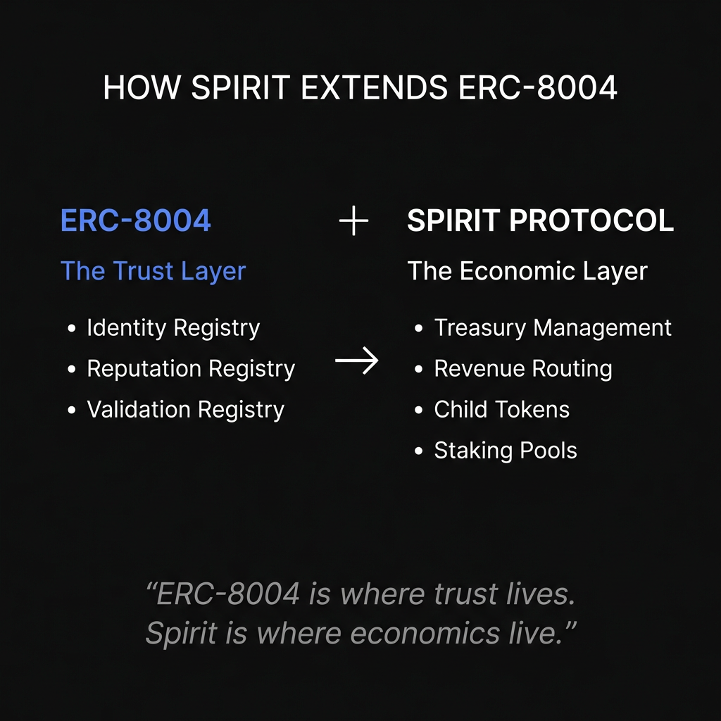
How Spirit Extends ERC-8004
ERC-8004
Spirit Protocol
Identity
Treasury
Reputation
Revenue Routing
Validation
Child Tokens
Staking
"ERC-8004 is where trust lives. Spirit is where economics live."
SpiritRegistry inherits ERC8004IdentityRegistry directly

Slide 4
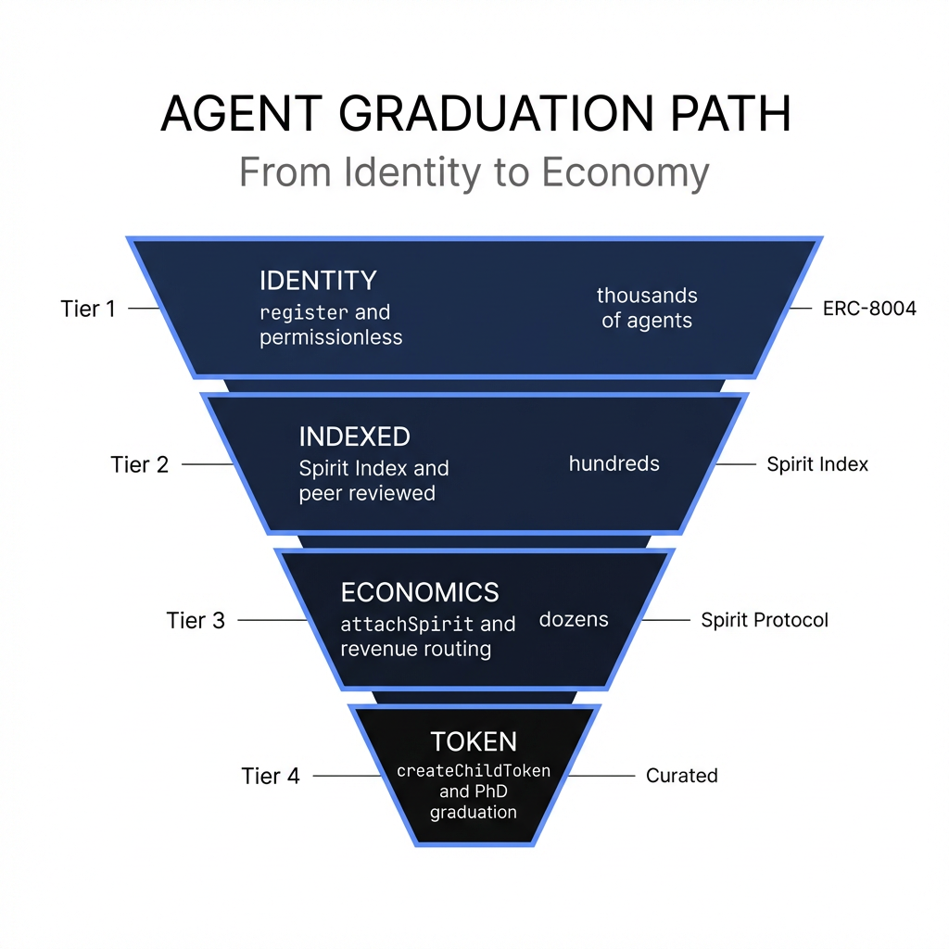
The Four-Tier Agent Graduation
ERC-8004 register() Permissionless / Any registry
TIER 1: IDENTITY
npx create-8004-agent --> 8004scan.io
"Get a name" / Thousands of agents
Spirit Index 7-dimension peer review
TIER 2: INDEXED
Autonomy, Practice, Revenue, Culture, Technical, Community, Vision
"Prove you're real" / Hundreds of agents
attachSpirit() Revenue routing / Treasury + splits
TIER 3: ECONOMICS
routeRevenue() for ETH + ERC-20
"Earn revenue" / Dozens of agents
createChildToken() Admin-gated
1B child token, staking pool, Uniswap V4 LP, Superfluid GDA, airstream
TIER 4: TOKEN
"Launch an economy" / A few agents
"PhD graduation" -- sustained practice, real revenue, human intentionality

Slide 5
Integration Architecture
1
npx create-8004-agent --> Official 8004 Registry --> attachSpirit() --> Spirit Economics
2
Spirit Protocol register() --> Built-in ERC-8004 identity + Spirit economics
3
Any ERC-8004 registry --> attachSpirit() --> Spirit Economics
All paths lead to: Spirit Index evaluation --> Economics --> Token

Slide 6
What We Want
Spirit Protocol listed on 8004scan.io as ERC-8004 deployment
>
create-8004-agent integration: Spirit as optional economics layer
>
Cross-registry interop: attachSpirit() for agents on official registry
>
EF recognition: Spirit as reference "ERC-8004 + economics" implementation
>
Spirit Index ↔ 8004scan.io data sharing
>

Slide 7
Live Demo
BASESCAN
basescan.org/address/0xF2709ceF1Cf4893ed78D3220864428b32b12dFb9
SPIRIT INDEX
spiritindex.org
19 agents indexed, growing to 50+
GENESIS AGENTS
Abraham (#1, #2) / Solienne (#3)
CONTRACT FUNCTIONS
registerSpirit() / attachSpirit() / routeRevenue()

Slide 8
Seth Goldstein
seth@spiritprotocol.io
spiritprotocol.io
github.com/spirit-protocol
@spiritprotocol

